Slide 1

Data Analysis & Knowledge discovery
Group Project
Xinyue Chen

Slide 2

Part 1
Regression
Data Preprocessing
Linear Regression
Group Lasso
Ridge Regression
Polynomial regression
Regression tree
Boosting

Slide 3
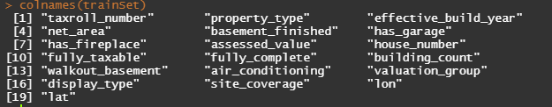
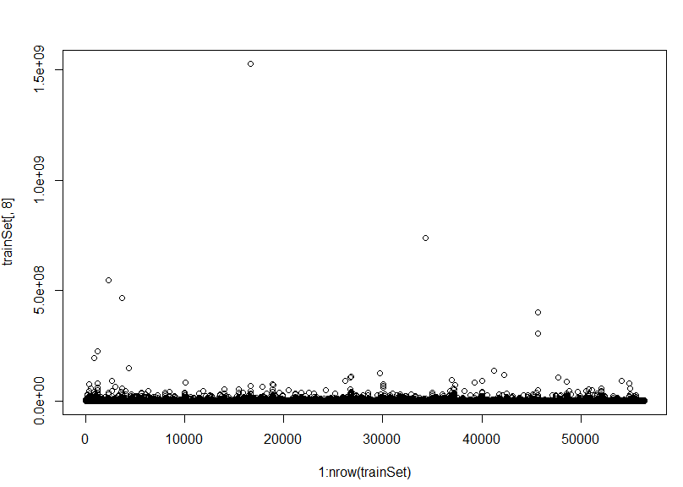
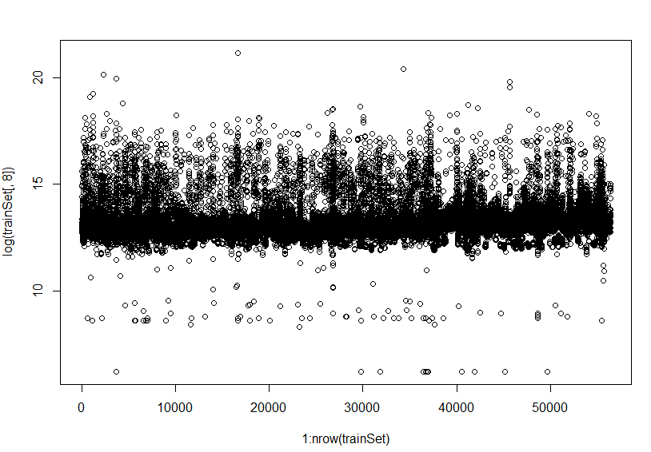
Data
Pre-processing
Totally 19 variables are reserved and 11 of them are categorical variables:
Before Log transform
After Log transform

Slide 4
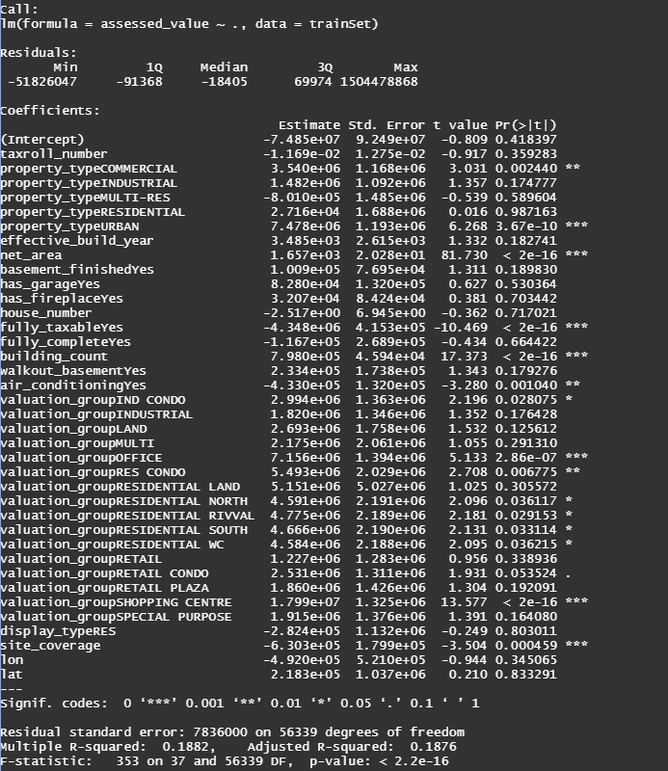
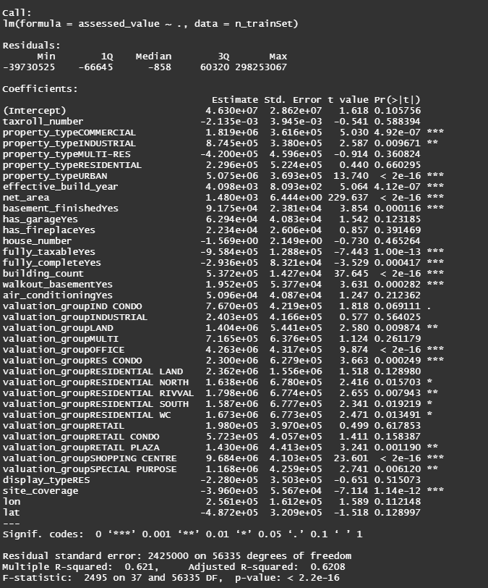
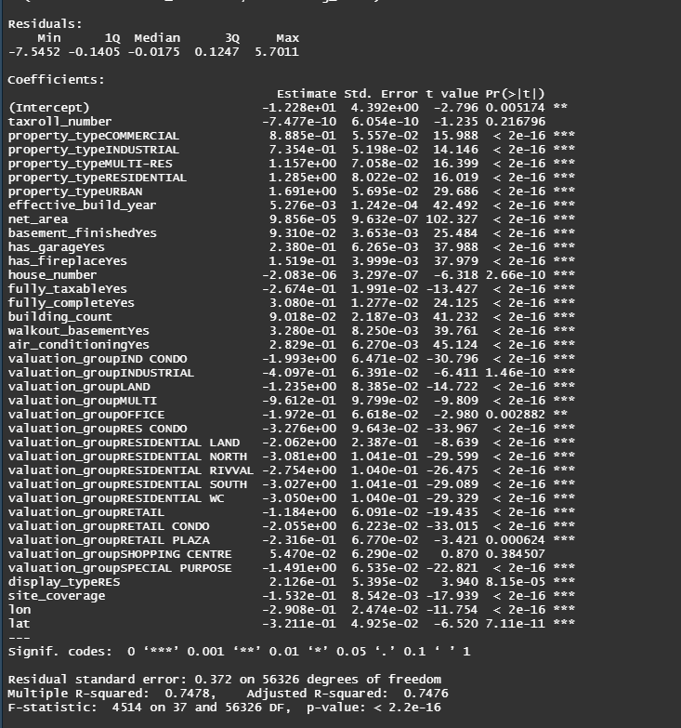
Linear
Regression
Original Dataset
Removing 4 leverage observation
Applying Log transform
 | Original data | Remove 4 leverage points | Take log-transform on the predicted value
RMSE | 1643067 | 1209026 | 3883287

Slide 5
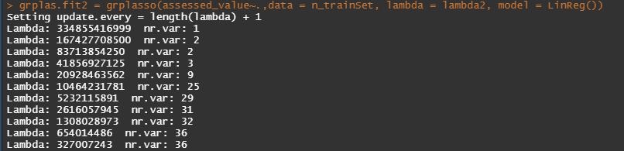
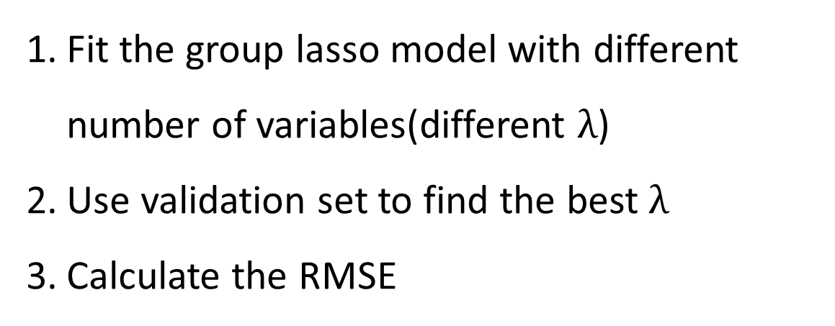
Group Lasso
Simple group lasso cannot be used for group selection, and not suitable for multilevel categorical variables. So, the group lasso approach is applied.
Fit the group lasso model with different number of variables(different $λ$)
Use validation set to find the best $λ$
Calculate the RMSE
 | Original data(No. of variables) | Remove 4 leverage points(No. of variables) | Take log-transform on the predicted value(No. of variables)
RMSE | 1234205(3 var.) | 1168305(25 var.) | 1847568(8 var.)
 | Net_area Building_count | Net_area; Building_count; Property (6 classes);fully_taxable Valuation(17 classes) | Net_area; Building_count Property (6 classes)

Slide 6
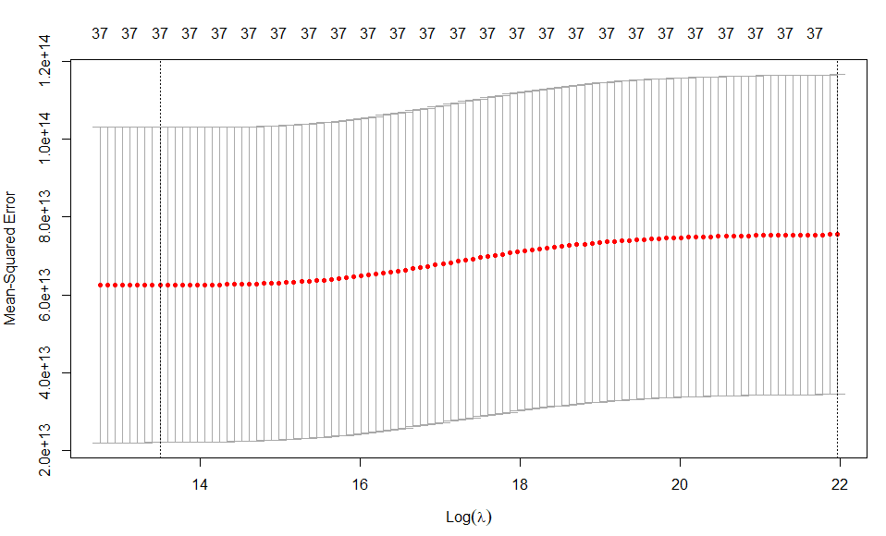
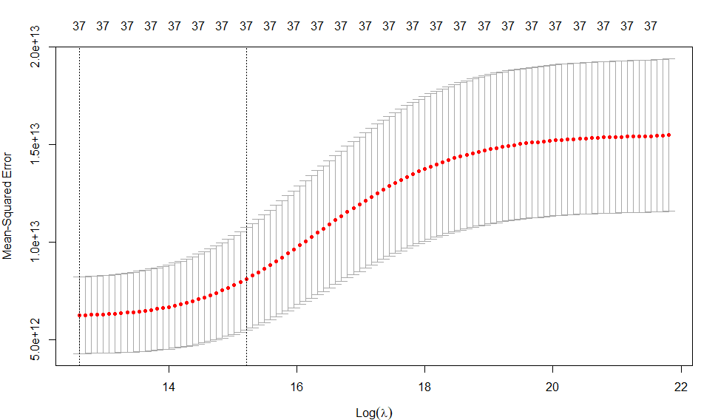
Ridge Regression
Fit the regression tree
Use cross validation to find the best tress size
Calculate the RMSE
Cross Validation curves:
 | Original data | Remove 4 leverage points | Take log-transform on the predicted value
RMSE | 1573103 | 1144672 | 3359222

Slide 7
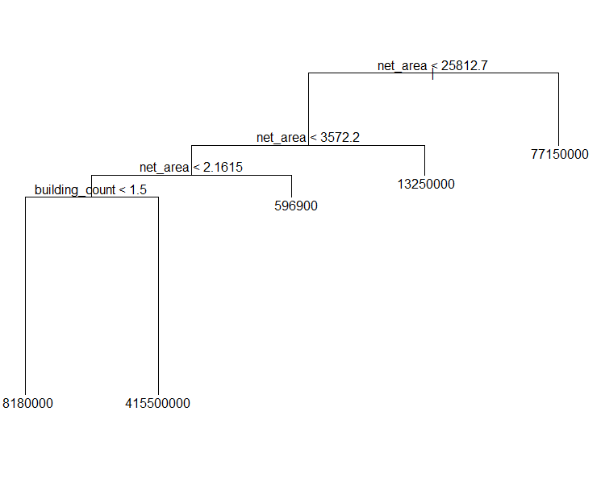
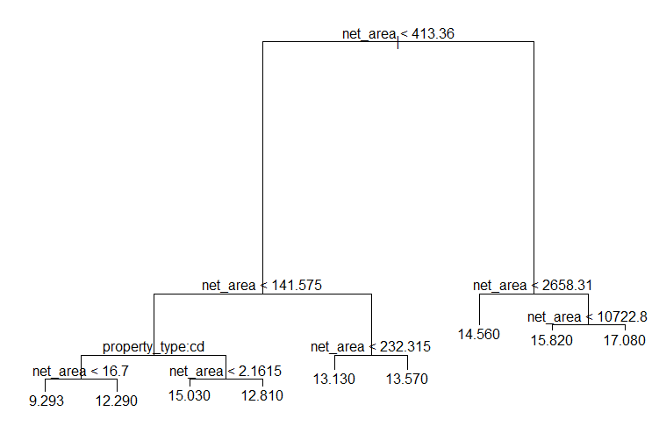
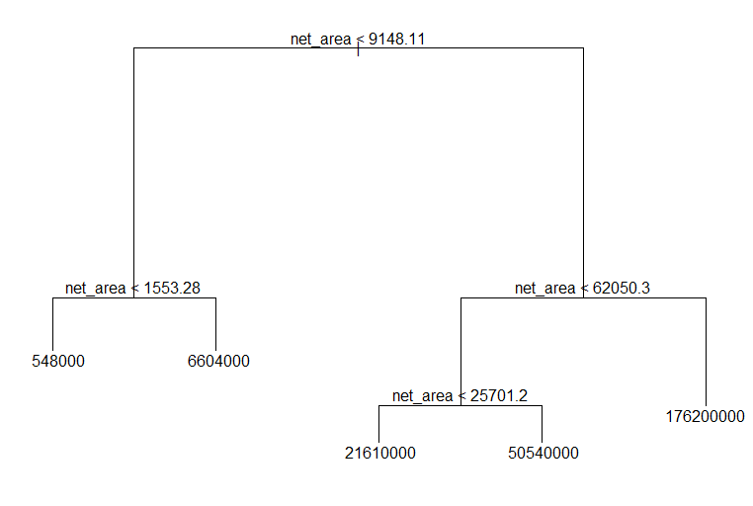
Regression
Tree
Fit the regression tree
Use cross-validation to find the best number of leaves
Calculate the RMSE
 | Original data | Remove 4 leverage points | Take log-transform on the predicted value
RMSE | 1832701 | 1409465 | 1348284

Slide 8
Polynomial Regression and Boosting
assessed_value~poly(net_area,2)+poly(building_count,3)
Polynomial | Original data | Remove 4 leverage points | Take log on the response
RMSE | 1479008 | 1299116 | 40327199
Number of trees: 5000 Tree depth: 1 Shrinkage: 0.1
Boosting | Original data | Remove 4 leverage points | Take log on the response
RMSE | 1621652 | 1381113 | 1293904

Slide 9
Summary
 | Original data | Remove 4 leverage points | Take log-transform on the predicted value
Linear Model | 1643067 | 1209026 | 3883287
Group Lasso | 1234205 | 1168305 | 1847568
Ridge Regression | 1573103 | 1144672 | 3359222
Regression Tree | 1832701 | 1409465 | 1348284
Polynomial | 1479008 | 1299116 | 40327199
Boosting | 1621652 | 1381113 | 1293904

Slide 10
Part 2
Classification
Data processing
Linear regression
LDA and QDA
Classification tree
Random forest
Boosting

Slide 11
attach(OpenData)
a=OurData$taxroll_number
newdata1=OpenData[c(Assessment.Year==2015),]
newdata2=OpenData[c(Assessment.Year==2016),]
b=match(newdata1$Account.Number,a)
index=which(b!=0)
newdata3=newdata1[index,]
length(index)
[1] 71523
c=match(newdata2$Account.Number,a)
index2=which(c!=0)
newdata4=newdata2[index2,]
length(index2)
[1] 71441
Data
Processing
Open property assessment data
(2015 and 2016)

Slide 12
attach(Data)
basement=as.numeric(basement_finished=="Yes")
...
Data2=data.frame(Data[,-c(remove NA)],basement,…)
Data2=na.omit(Data2)
effective_build_year=as.numeric(Data2$effective_build_year)
…
Prediction=rep(0,70620)
Prediction[Data2$X2016.Assessed_Value>Data2$X2015.Assessed_Value]=1
Data3=data.frame(Data2[,-c(remove predictors)],effective_build_year,…)
dim(Data3)
[1] 70620 19
names(Data3)
Data
Processing
[1] "taxroll_number" "net_area"
[3] "house_number" "M2_1"
[5] "M2_2" "lon"
[7] "lat" "X2015.Assessed_Value"
[9] "X2016.Assessed_Value" "basement"
[11] "garage" "fireplace"
[13] "taxable" "complete"
[15] "walkout.basement" "air.conditioning"
[17] "effective_build_year" "building_count"
[19] "Prediction"

Slide 13
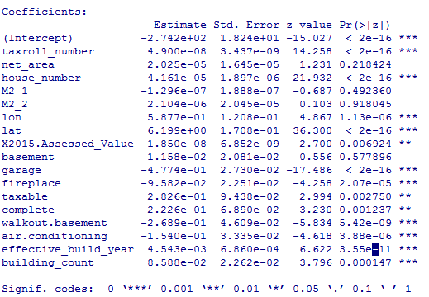
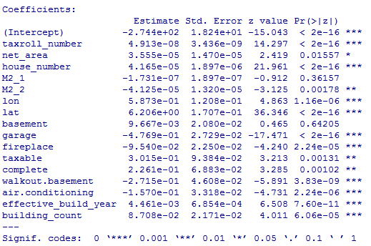
2015_assessed_value included
Logistic Regression
2015_assessed_value not included
Error rate: 32.696%
32.739%
(after removing insignificant predictors)
Error rate: 32.739%
32.795%
(after removing insignificant predictors)

Slide 14
LDA and QDA
Model | 2015_assessed_value included (%) | 2015_assessed_value not included (%)
Logistic regression | 32.696 | 32.739
LDA | 28.066 | 28.122
QDA | 27.584 | 33.617
1. The observations can be Gaussian.
2. 2015_assessed_value is a significant predictor.

Slide 15
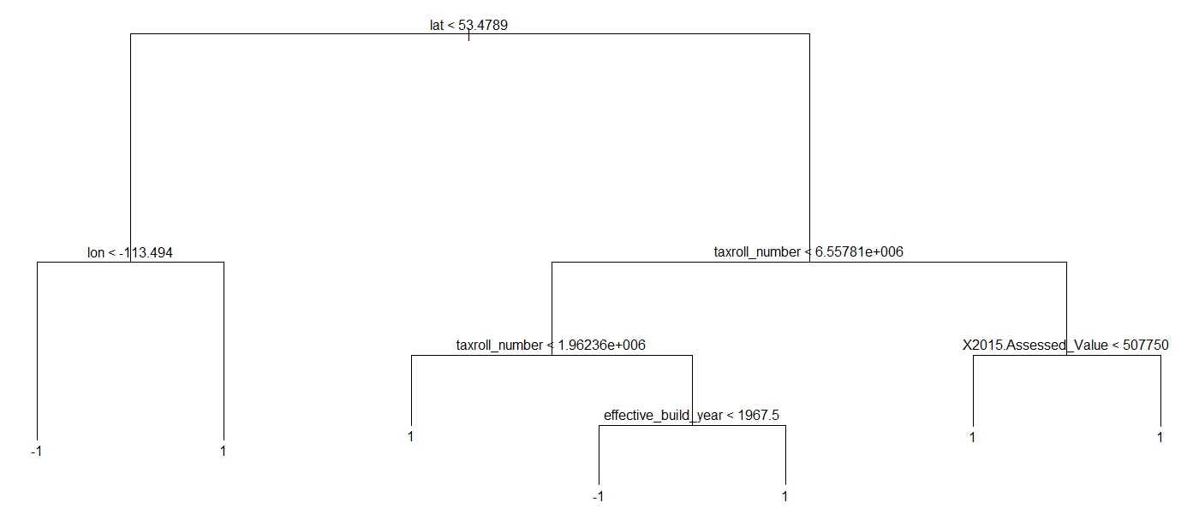
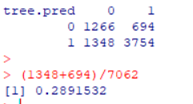
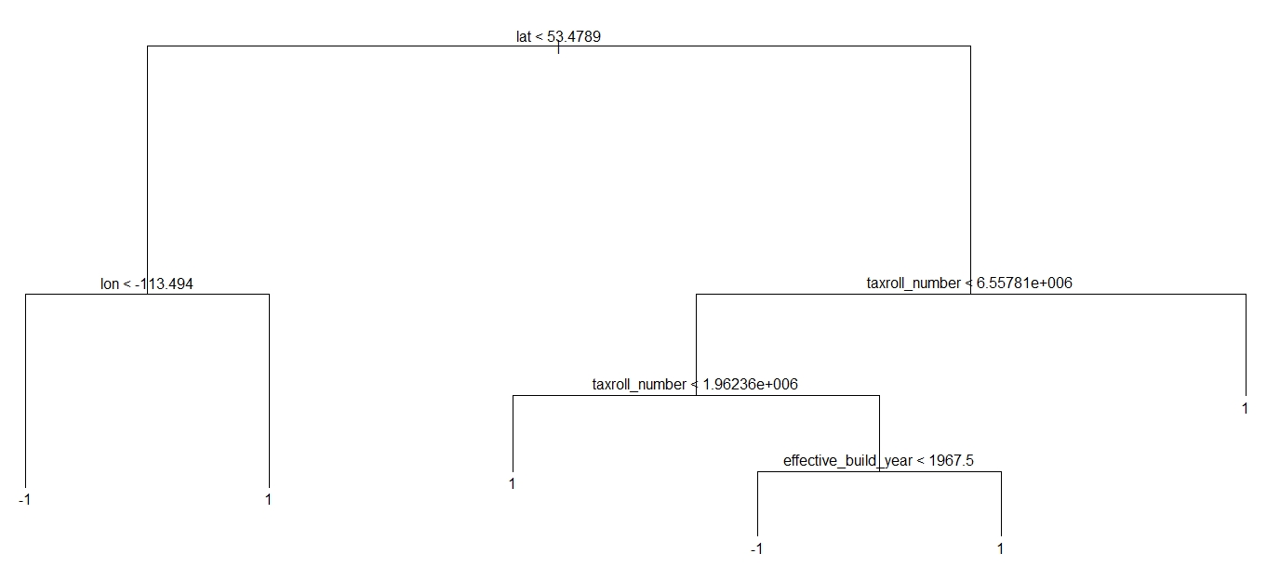
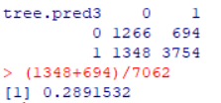
2015_assessed_value included
Classification
Tree
2015_assessed_value not included
Using unpruned trees first.
Using pruned trees then.
Pruned trees did not improve the accuracy.
Pruned tree cannot select the best tree size.

Slide 16
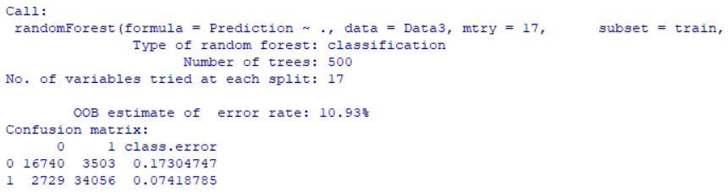
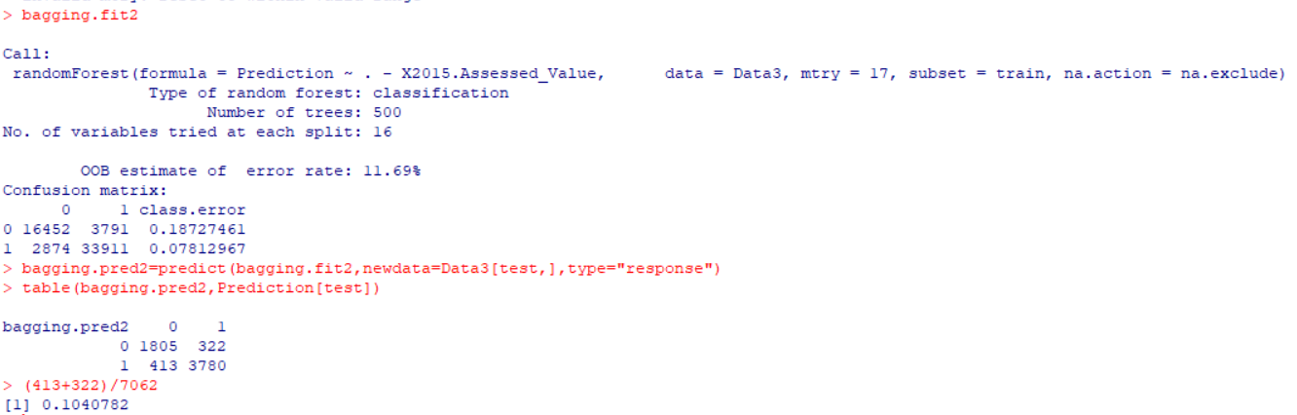
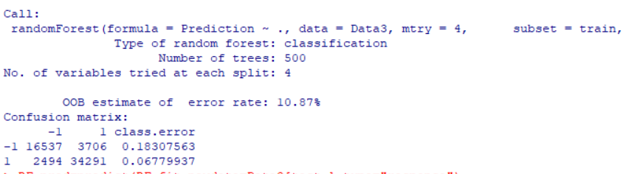
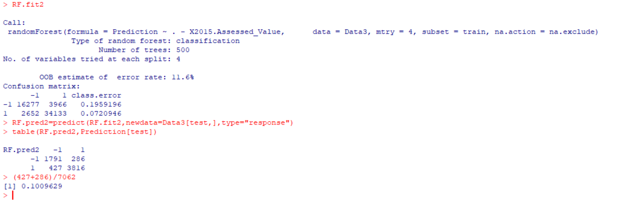
Bagging
Error rate: 9.771%
Error rate: 10.408%
Random Forest
Error rate: 9.742%
Error rate: 10.096%
2015_assessed_value included
2015_assessed_value not included
Random forest has higher test set accuracy than the bagging.

Slide 17
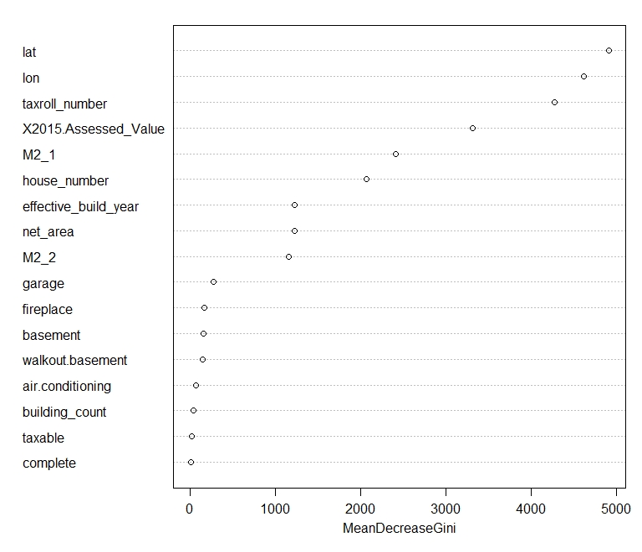
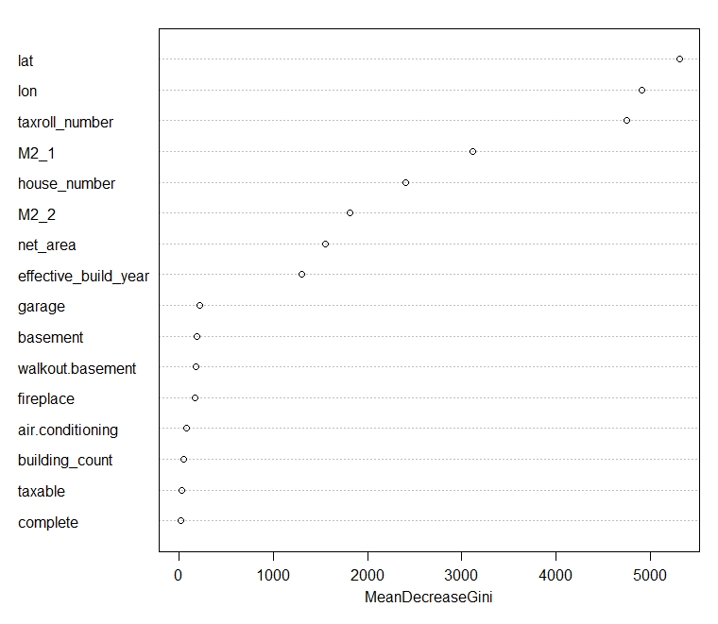
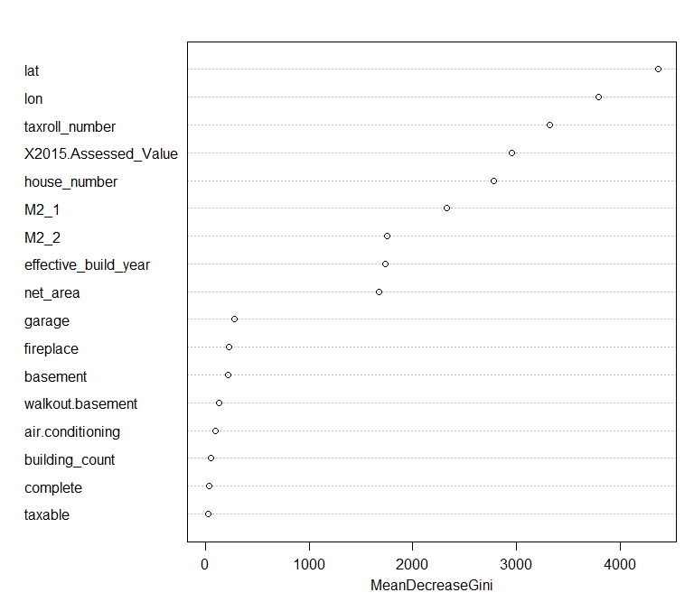
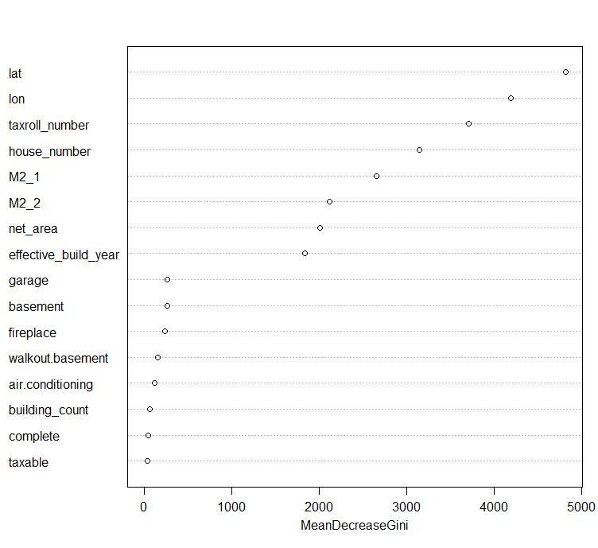
Bagging
Random
Forest
2015_assessed_value included
2015_assessed_value not included

Slide 18
boost.fit=gbm(Prediction~.,
data=Data3[train,],distribution="bernoulli",
n.trees=500,interaction.depth=6,shrinkage=0.01)
boost.fit2=gbm(Prediction~.-X2015.Assessed_Value,
data=Data3[train,],distribution="bernoulli",
n.trees=500,interaction.depth=6,shrinkage=0.01)
Boosting
Error rate: 22.175%
2015_assessed_value included
Error rate: 23.025%
2015_assessed_value not included

Slide 19
Model | Test error rate 1 (%) | Test error rate 2 (%)
Logistic regression | 32.696 | 32.739
LDA | 28.066 | 28.122
QDA | 27.584 | 33.617
Classification tree | 28.915 | 28.915
Bagging | 9.771 | 10.408
Random forest | 9.742 | 10.096
Boosting | 22.175 | 23.025
Summary

Slide 20
Thank you for watching!
Zuyuan Tian
Xinyue Chen
Department of Electrical & Computer Engineering

